Slide 1
DATA EXPLORATION REPORT- THE FIVE HORSEMEN
EGE ONUR GÜLEÇ
ŞERİF KAYA ÇINAR
HASAN MEHMET ÇETİN
BURAK TAŞDEMİR
ALP AKKAYA

Slide 2
https://www.kaggle.com/c/rossmann-store-sales/data
Our data comes from a kaggle competition which we will use to predict the future sales of the given stores for 6 weeks of period.

Slide 3
Our feature list:
Id - an Id that represents a (Store, Date) duple within the test set
Store - a unique Id for each store
Sales - the turnover for any given day (this is what you are predicting)
Customers - the number of customers on a given day
Open - an indicator for whether the store was open: 0 = closed, 1 = open
StateHoliday - indicates a state holiday. Normally all stores, with few exceptions, are closed on state holidays. Note that all schools are closed on public holidays and weekends. a = public holiday, b = Easter holiday, c = Christmas, 0 = None
SchoolHoliday - indicates if the (Store, Date) was affected by the closure of public schools
StoreType - differentiates between 4 different store models: a, b, c, d
Assortment - describes an assortment level: a = basic, b = extra, c = extended
CompetitionDistance - distance in meters to the nearest competitor store
CompetitionOpenSince[Month/Year] - gives the approximate year and month of the time the nearest competitor was opened
Promo - indicates whether a store is running a promo on that day
Promo2 - Promo2 is a continuing and consecutive promotion for some stores: 0 = store is not participating, 1 = store is participating
Promo2Since[Year/Week] - describes the year and calendar week when the store started participating in Promo2
PromoInterval - describes the consecutive intervals Promo2 is started, naming the months the promotion is started anew. E.g. "Feb,May,Aug,Nov" means each round starts in February, May, August, November of any given year for that st

Slide 4
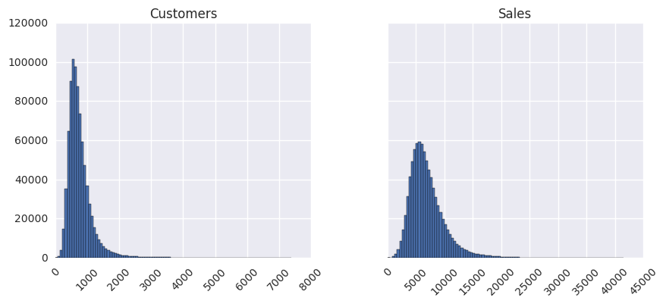
We check the distribution of sales and customers when stores are open. Left skewed

Slide 5
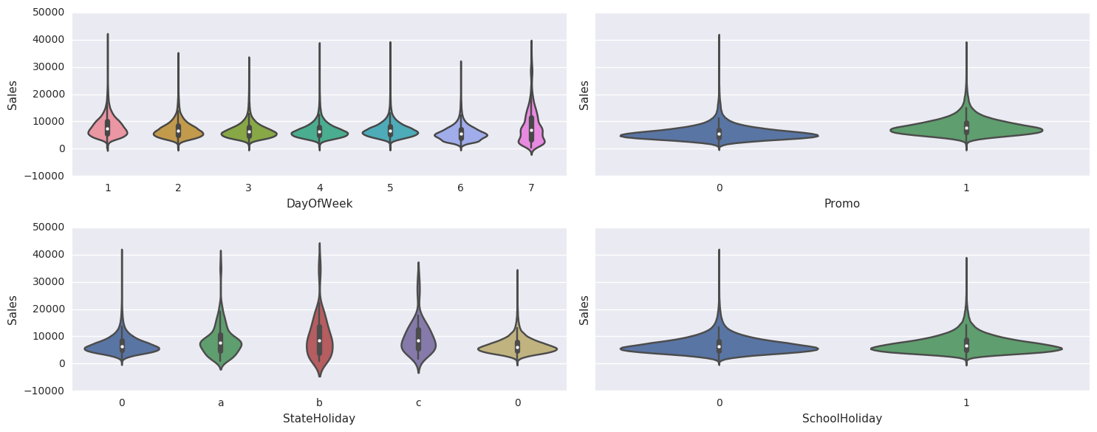
Violin plots show how the sales change in terms of our features

Slide 6
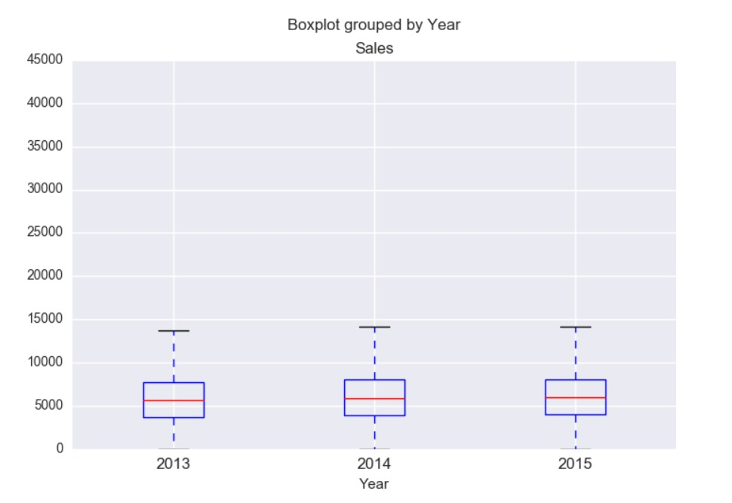
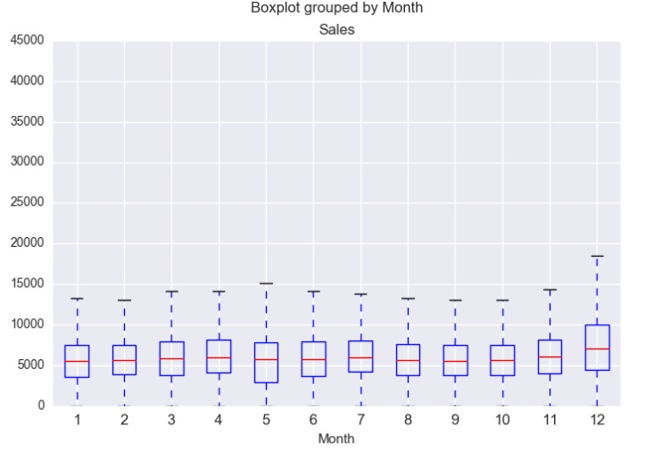
How sales change with respect to year and months.

Slide 7
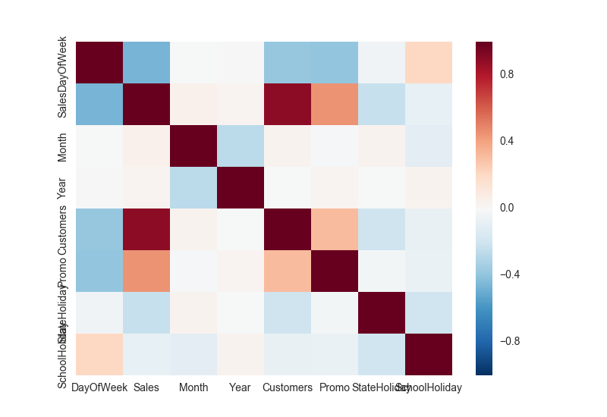
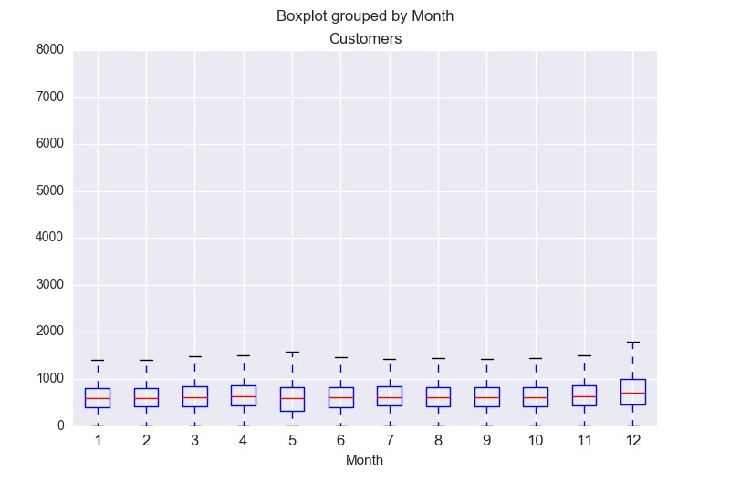
Pairwise correlations of features
How customer number changes with respect to months.

Slide 8
Ml algorithms we will use are random forest, xg boost and time series analysis
Random forests or random decision forests are an ensemble learning method for classification, regression and other tasks that operates by constructing a multitude of decision trees at training time and outputting the class that is the mode of the classes or mean prediction of the individual trees. This will allow us to find which features are important for us.

Slide 9
Time series: A time series is a series of data points indexed in time order. Most commonly, a time series is a sequence taken at successive equally spaced points in time. Thus it is a sequence of discrete-time data.
XG Boost is a decision-tree-based ensemble Machine Learning algorithm that uses a gradient boosting framework

Slide 10
We will use random forest and XG boost to determine to which features are important which are not for our forecast. Also we need to do time series analysis to understand the sales within different days and months of the year. After that we will use both algorithms to predict to future sales of the 1115 stores for six weeks of period in test.cv and compare the results of both algorithms in terms of their significances and efficiencies. In the end we will try to come up with a reasonable solution for the task.

